Slide 1
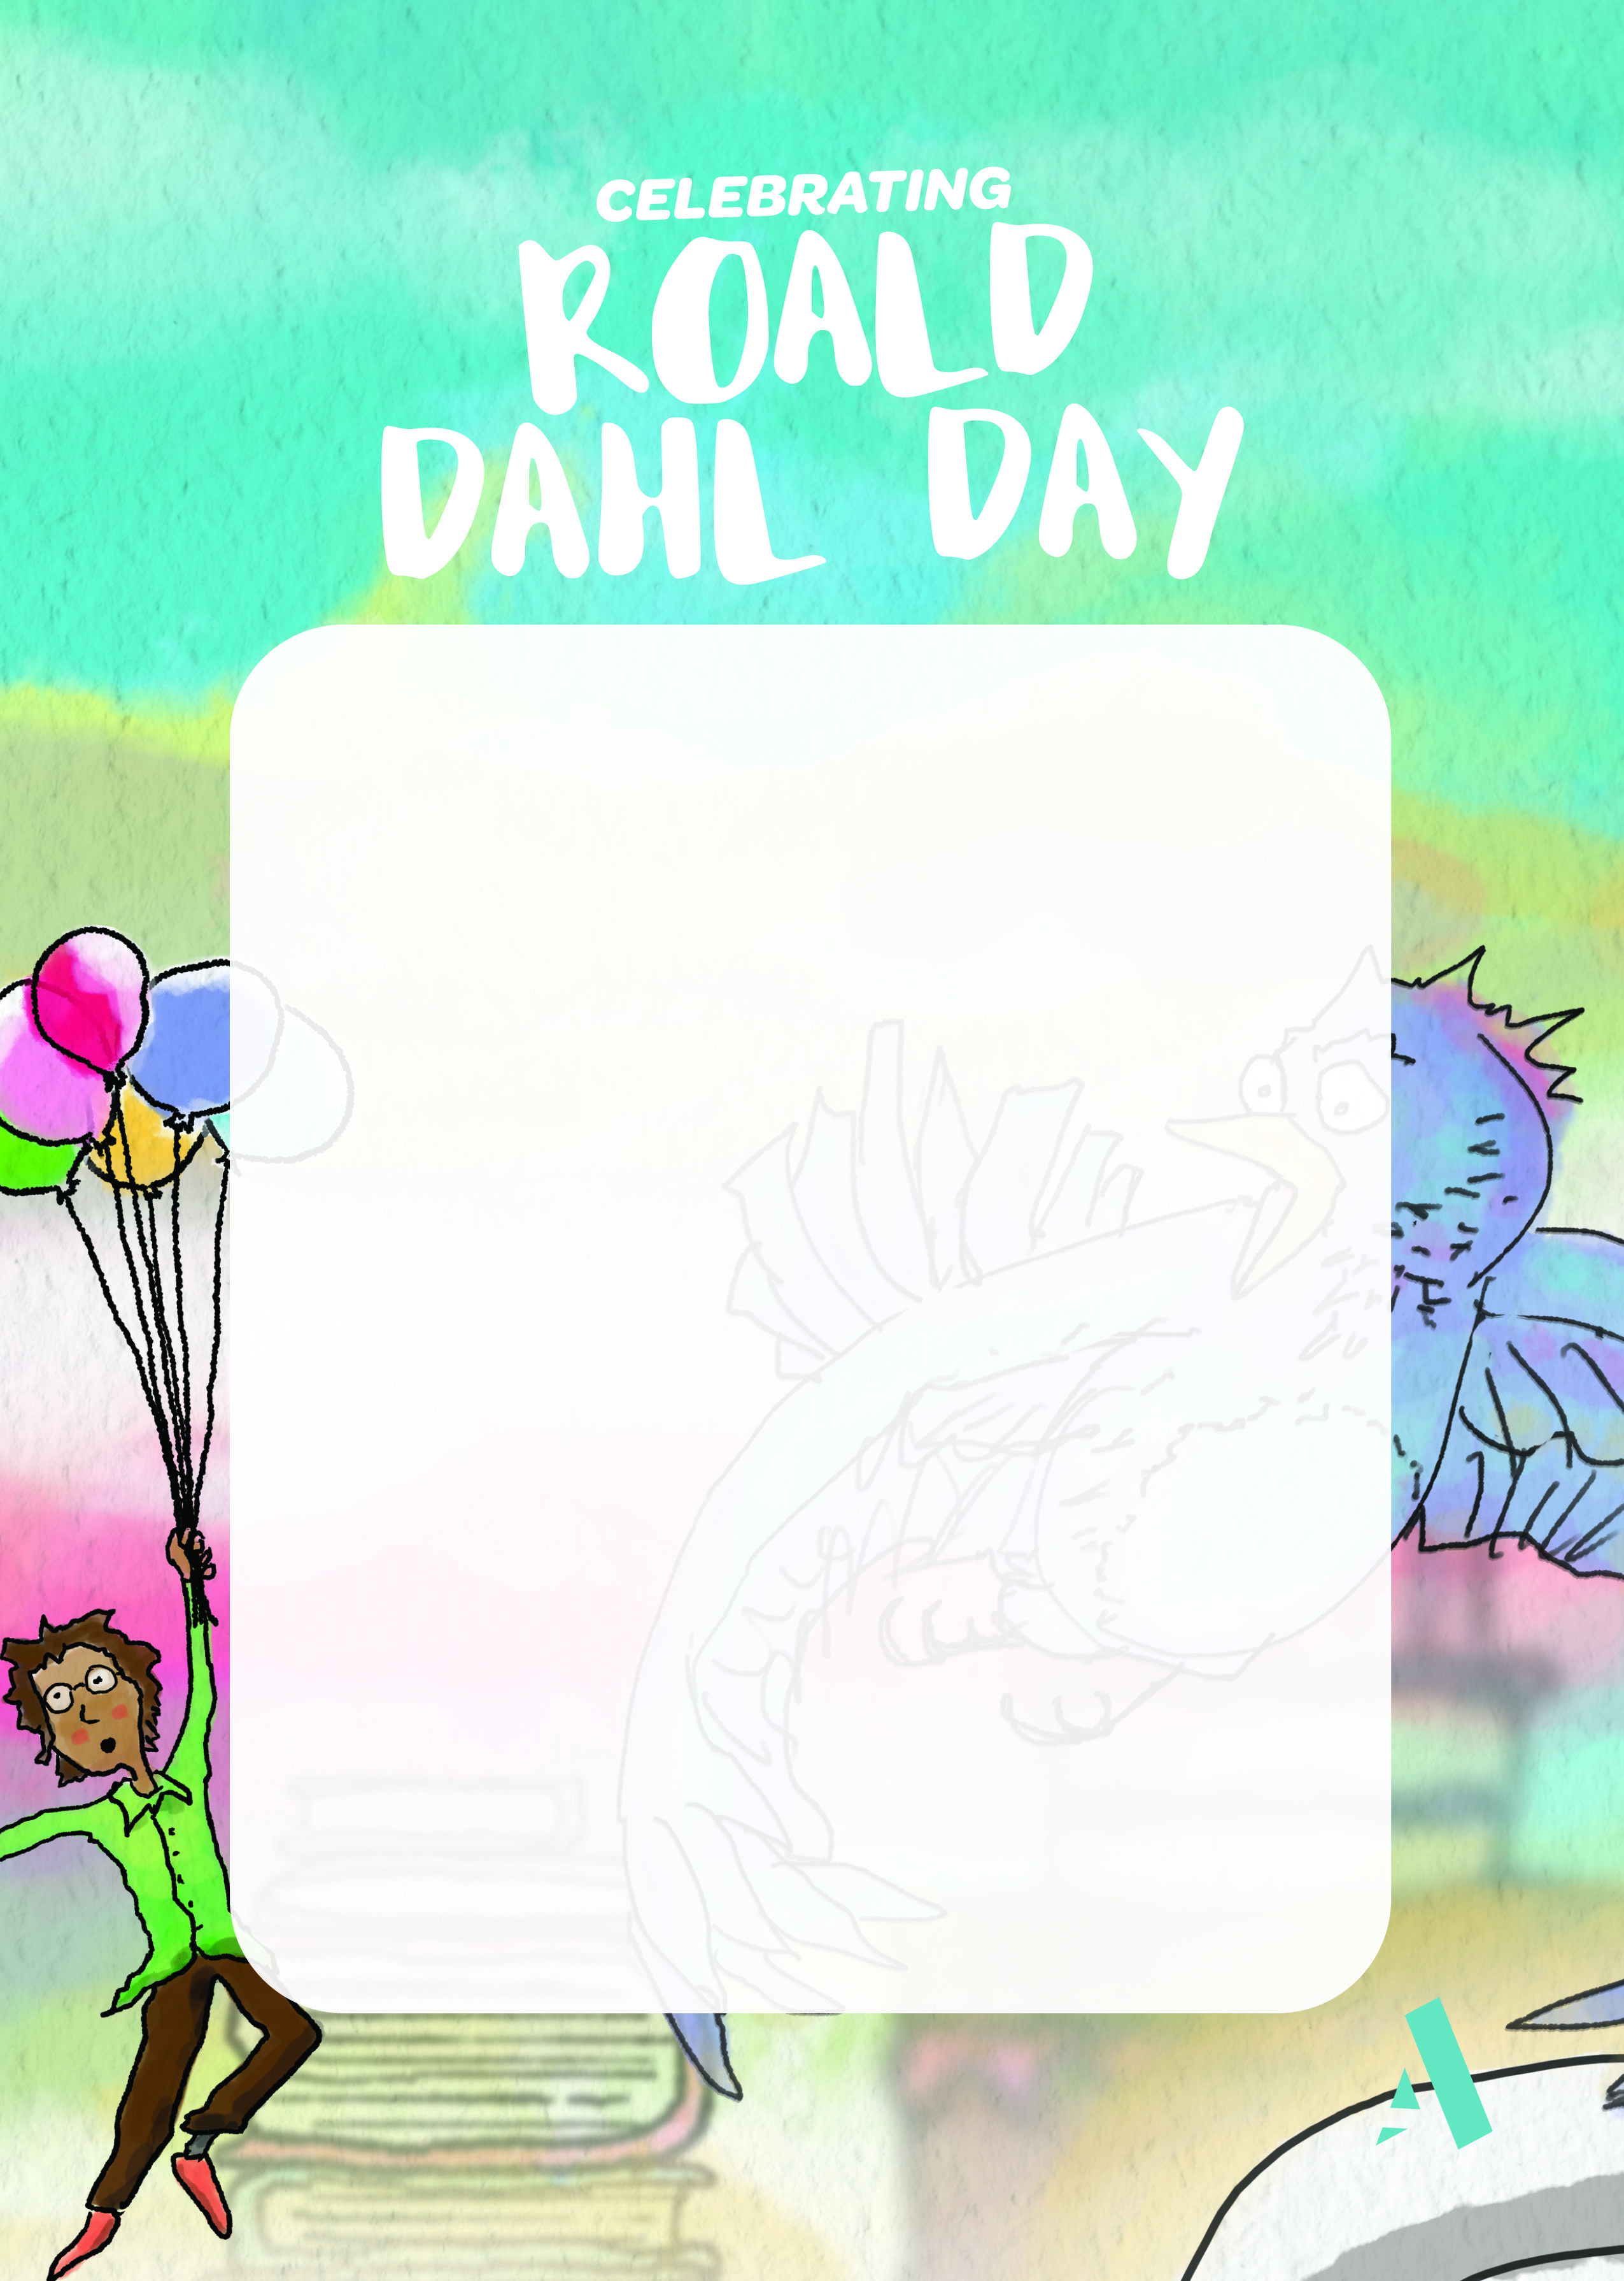
Thursday 5th March 2026
Oven Baked MudBurger
or
Vegetarian Mudburger
featured in ‘James & The Giant Peach’
Witches’ Finger Chips
from ‘The Witches!’
Amazing Seasonal Vegetables
Snozzcumber Salad
Will be available in the Salad Wheelbarrow
From ‘The Big Friendly Giant’
(BFG)
Willy Wonka Chocolate Cup Cakes
Consumed in Charlie & The Chocolate factory

